Slide 1


3rd Public Workshop: Trip & Equipment Grant Allocation Methodology
August 7, 2020

Slide 2

Objectives of the Public Workshop
Gain an understanding of the current allocation methodology of the Trip & Equipment Grant;
Explore datasets that could be applied to (or enhanced in) the funding formula; and
Gather input on potential changes to the methodology adopted in Rule 41-2.014, FAC

Slide 3

Meeting Rules
This is a public meeting under Florida’s Government in the Sunshine Act.
This meeting is being recorded.
All audio and phone lines are muted.
Speakers that submitted a public comment form will be selected first.
Webinar speakers will be unmuted when called on by the meeting facilitator.
Phone participants will be instructed on unmuting their phone lines.
All speakers during public input will be limited to 5 minutes.

Slide 4

Webinar Tutorial

Slide 5

Funding Allocation Study
Summary of Analysis & Proposed Changes

Slide 6

“Decisions will be better, and better understood and supported, if transparency, discussion and debate, communication and collaboration precede them.”
Robert Gates
Former U.S. Secretary of Defense

Slide 7
Study Objectives
Conduct an in-depth analysis of data used within the current allocation methodology
01
Facilitate stakeholder workshops to gather input on funding models for future consideration
02
Develop a final report that recommends changes to the funding methodology to be implemented in rule by July 1, 2021.
03

Slide 8
Guiding Principles
Access
Ensure Floridians who are transportation disadvantaged have access to community
Innovation
Allow local systems to test and apply new ideas to services.
Coordination
Promote cost-effective delivery of TD services.
Accountability
Ensure state taxpayer funding is being spent for its intended purpose.
Transparency
Make information available and understandable to stakeholders.

Slide 9

Trip & Equipment Grant
Allocation methodology established in Rule 41-2.014(5), FAC.
Consists of two components:
Base Funding – Based on a county’s equivalent allocation in FY1999-00.
Formula Funding – Based on four variables that equally measure demand and performance of transportation disadvantaged services in a county:
Total Population (demand)
Total Geographic Square Miles (demand)
Total Annual Operating Report (AOR) Trips (performance)
Total AOR Vehicle Miles (performance)
Funds are disbursed to the county’s Community Transportation Coordinators (CTC) after TD services are rendered.

Slide 10


Allocations VS Disbursements

Slide 11

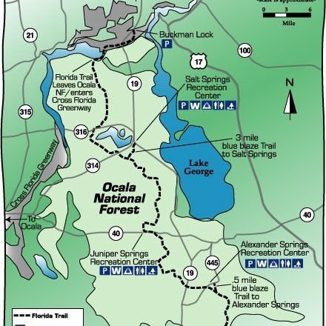
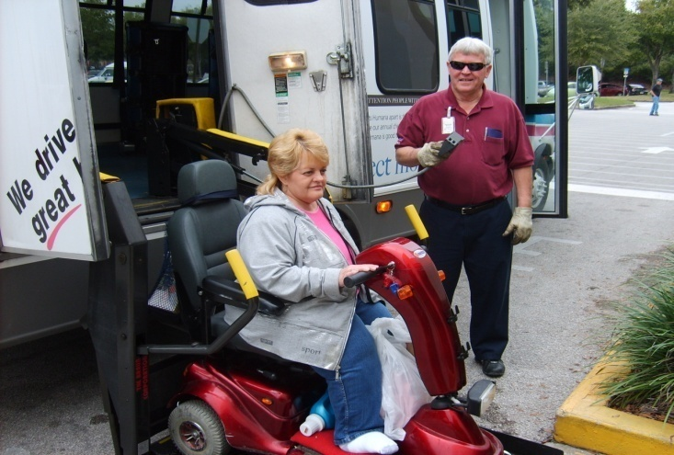
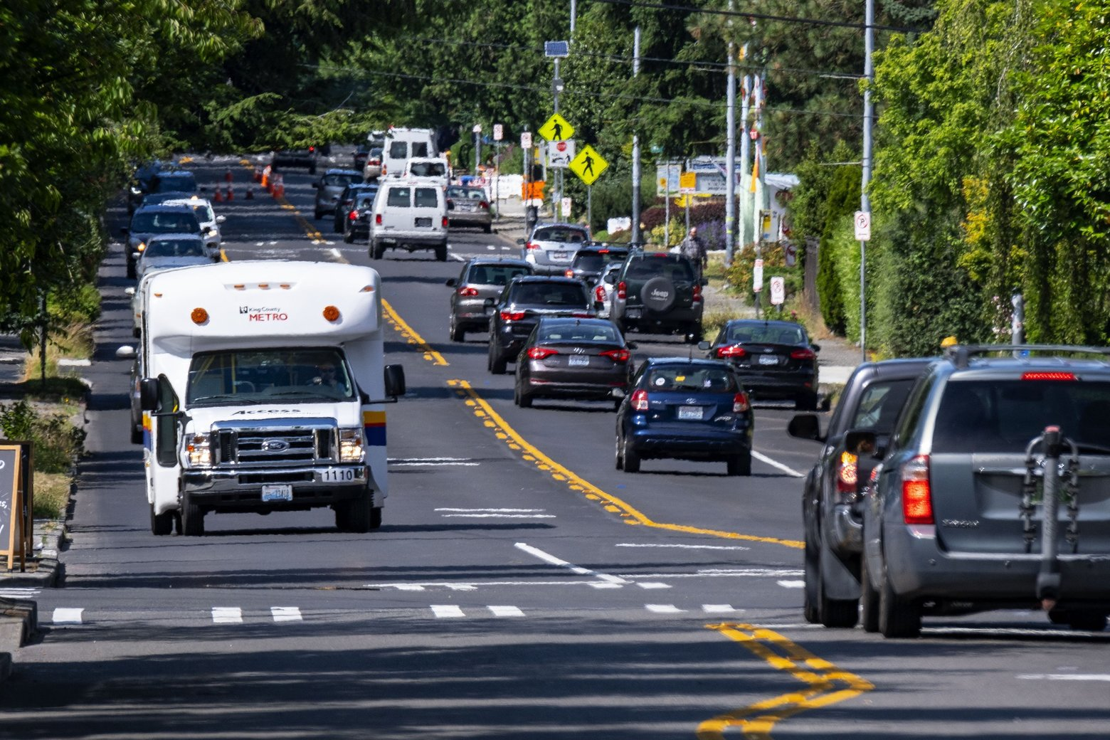
Data Sources Explored by Study
The American Community Survey (ACS) – 5-Year Population Data
Federal Highway Administration (FHWA) – Public Roads Mileage Data
CTD Annual Operating Report (AOR) – Systemwide Service Data
CTD Trip & Equipment Program Invoices – TD (Non-Sponsored) Service Data

Slide 12
Analysis of Individual Variables
Each dataset is identical or analogous to a variable within the Formula
Proposed models consider balance of demand vs performance variables.
This study explores the use of more precise estimates or measures within each of these variables.
Intended to adhere the variables to the guiding principles of the study by using the more precise measures.

Slide 13

Summary of Proposed Changes
The study presents four changes (variables) for consideration:
TD Population – Using ACS 5-year data (Table C18130), allocate funds more directly to county residents eligible to be served by the TD program.
Centerline Miles – As an alternative to square miles, allocate funds to a county’s total miles of public roads using FHWA data.
T&E Grant Funded Services – Instead of AOR systemwide trips/miles, allocate funds only for TD non-sponsored services (trips, miles, bus passes) using T&E invoice data.
Base Funding – Add the Base as a variable within the Formula and allocate funds based on a percent of a county’s previous year allocation (instead of the amount from FY1999-00).

Slide 14

Proposed Variable Weights
The funding models for consideration assign different weights to datasets within each of the variables, with “1.0” as the standard value.
TD Population – All individuals who fall under at least one of three TD eligible groups (disabled, below poverty, and/or 65 years and older) are weighted equally at 1.0
CLM – Roads data are categized into four population sizes (rural, small urban, small urbanized, and large urbanized), all equally weighted at 1.0.
T&E Services – The different types of trips and bus passes are weighted at an amount relative to the unit cost (or rate) of an ambulatory trip.
A wheelchair trip, for example, is weighted at 1.7 because it is reimbursed 1.7 times the cost of an ambulatory trip.
Miles are weighted at 0.1 the amount for an equivalent type of trip, so that each additional mile in a trip adds 0.1 to the total for the trip.

Slide 15

Calculating Statewide Shares: Alachua County
Once the weighted totals for each variable are tallied, a statewide share for each county by variable can be calculated. Using Alachua County as an example:
Share of TD Population: (96,121/7,589,002) = 1.27%
Share of Centerline Miles: (1,820,154/123,099,224) = 1.48%
Share of T&E Services: (44,483,050/5,290,813.776) = 0.84%
Share of Base: ($650,821/$56,538,360) = 1.15%
Any model that gives greater weight to a variable that represents a higher statewide share for a county will result in more funds being allocated toward that same county.

Slide 16

Models for Consideration
The study presents three models, with varying weighted totals and statewide shares by variable:
Model | Demand (TD + CLM) | Performance | Base | Description
Model 1 | 12.5%+12.5% | 25% | 50% | “Status Quo” approach, uses the similar balance as current formula, just with different datasets
Model 2 | 6.25%+6.25% | 37.5% | 50% | Performance-driven approach, where more weight is given to prior year performance in T&E services
Model 3 | 18.75%+18.75% | 12.5% | 50% | Demand-driven approach, where more weight is given to a county’s TD population and CLM

Slide 17

Calculating Alachua County Share in Each Model
With statewide shares calculated for each county and weights assigned to each variable, it then becomes possible to calculate each county’s share of the total amount appropriated for the T&E Grant (allocation factor) under each model. Taking Alachua County as an example again:
Proposed Variable: Model 1 Model 2 Model 3
Share of TD Population: (1.27%*12.5%) (1.27%*6.25%) (1.27%*18.75%)
Share of CLM: +(1.48%*12.5%) +(1.48%*6.25%) +(1.48%*18.75%)
Share of T&E Services: +(0.84%*25%) +(0.84%*37.5%) +(0.84%*12.5%)
Share of Base: +(1.15%*50%) +(1.15%*50%) +(1.15%*50%)
Allocation Factor =1.13% =1.06% =1.20%

Slide 18
Allocation Amounts for Alachua County Under Each Model
Finally, after calculating the allocation factor under each model, it becomes possible to determine the allocation amount for each county. Using Alachua County as the example:
*Models 1, 2, and 3 assume total funding equal to FY 2020-21 appropriation
Proposed Variable | Model 1 | Model 2 | Model 3 | FY2019-20 (Pre-”Hold Harmless”) | FY2018-19
TD Population | $89,795.08 | $$44,897.54 | $134,692.62
CLM | $104,826.66 | $52,413.33 | $157,239.99
T&E Services | $119,212.29 | $178,818.43 | $59,606.14
Base | $326,435.42 | $326,435.42 | $326,435.42
Total Allocation | $640,269.45 | $602,564.72 | $677,974.18 | $650,820.54 | $605,854.51

Slide 19

Discussion of Stakeholder Input
Summary of Feedback Received at Workshops and Website

Slide 20

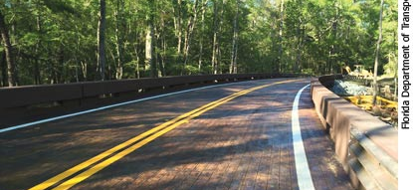
Feedback on Demand Variables
Using TD population (instead of general population) narrows the scope to identify those who are truly eligible and in need of services.
Rural systems tend to travel further distances to access certain services, such as medical facilities in neighboring urbanized areas.
Using centerline miles reinserts population as a second variable in the formula, which favors more urbanized counties.
Does the CLM data include dirt roads? Does it include private roads in gated communities?

Slide 21

A Closer Look at Centerline Miles
Removal of CLM would leave population as a stand-alone variable, which would reduce allocations for smaller counties.
The CLM variable benefits smaller counties based on CLM per capita, not total miles of public roads.
The CLM per capita is higher in smaller counties due to longer distances to travel.
See full analysis on impact of CLM at: https://ctdallocationstudy.com/index.php/data/interim-reports/.
CLM data include dirt roads, but do not include private roads in gated communities. See “Public Road Mileage and Travel (DVMT) Report” at: https://www.fdot.gov/statistics/mileage-rpts/default.shtm#Locals.

Slide 22
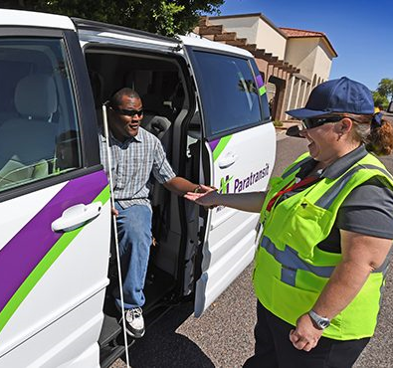
Feedback on Performance Variable
Debate over the use of AOR data within the formula:
Some argue removal due to a lack of credible, accurate data across the system.
Some argue its use incentivizes CTCs to work with coordination contractors and purchasing agencies.
The formula should consider costs associated with providing longer distance trips (urban and rural).
Debate over the use of bus passes within the formula:
Some argue removal to favor rural systems that do not have robust fixed-route transit services.
Some argue for inclusion of actual trips allotted for the pass to incentivize the use of fixed-route systems.
How will trips that exceed the allocated amount (“overage” in T&E invoice data) be addressed?

Slide 23

Feedback on Base and Other Factors
Consider a phase-in approach to allow systems time to adjust to new formula.
Add a “floor” and “cap” to prevent a certain percentage of loss or gain in allocations to phase-in new formula.
Consider trip purposes, with greater weight given to medical-related trips.
Delay implementation due to COVID-19 impact on services (i.e., invoice data).

Slide 24

A Closer Look at Performance

Slide 25

Questions to Consider
What weight should be given to T&E invoice miles relative to trips?
Should miles be given more weight or less weight than one-tenth an equivalent type trip?
Should the performance variable be delayed for one year because some systems may report miles differently (i.e., passenger, vehicle, or direct)?
How should weights be assigned to bus passes (i.e., daily, weekly, monthly, etc.) reimbursed under the T&E Grant?
Should the funding model consider trips (and miles) that exceed the allocated amount (“overage”) for a given month or year?
If so, to what extent should these trips/miles be weighted relative to trips/miles within allocated amount?

Slide 26

Understanding the Weights for Trips/Miles
The weights from the initial report (Table 4C) are based on the average rates that CTCs are reimbursed under the T&E Grant.
An ambulatory trip is given the baseline weight of 1.0.
A wheelchair trip is weighted at 1.7 because it is reimbursed on average 1.7 times the cost of an ambulatory trip.
Miles are weighted at 0.1 the amount for an equivalent type of trip, so that each additional mile in a trip adds 0.1 to the total for the trip…

Slide 28
“Service differentiation factors were created for each different service type based upon load/unload time . . . The current rate model established Ambulatory as the baseline . . . when computing multiple service rates”
-Thomas Howell Ferguson, 2019 Rate Model Report

Slide 29

Understanding the Weights for Bus Passes
CTD purchases bus passes to subsidize the fare for TD riders to use the fixed-route system, where available.
Bus passes overwhelmingly are based on the number of days – not number of trips – allotted for riders:
Cost of the pass does not change based on number of trips taken by the rider
Bus pass rates can also be compared relative to baseline ambulatory rate.
Proposed models weigh passes significantly higher to incentivize use when available…

Slide 31
*Note: Ambulatory mile rates are multiplied by 10 for the purposes of comparing a bus pass rate to an ambulatory trip.
For every type of bus pass (monthly, 10 day, weekly, daily, single trip), the proposed weights in the initial report exceed the maximum relative cost for that pass found statewide

Slide 32

Other Factors to Consider in Invoice Data
Some CTCs provide TD services that exceed the allocated amount (“overage”):
Usually provided by local government funds.
May be captured in the AOR, but not necessarily the invoice data.
T&E Grant allows CTCs to use up to 25% of allocation to purchase capital equipment.
“Mileage” reported in the invoice data may vary and include:
Passenger – the miles traveled with the rider on the vehicle.
Vehicle – the miles a vehicle travels on the road.
Direct – the miles between the rider’s pick-up and drop-off locations.

Slide 33
Other Factors to Consider in Invoice Data: Example Solution for Overage
FORMULA
( Initial Weighted Trip Count ÷ Billed Amount Relative to Allocation Amount ) +
{[ Initial Weighted Trip Count – ( Initial Weighted Trip Count ÷ Billed Amount Relative to Allocation Amount )] * Weight Given to Overage }
EXAMPLE 1: 1,100 Trips provided at $100 per Trip and No Overage Allowed
EXAMPLE 2: 1,100 Trips provided at $100 per Trip and Partial Overage Allowed (counted 50%)

Slide 34
Other Factors to Consider in Invoice Data: Example Solution for Capital Equipment Purchases
FORMULA
Initial Weighted Trip Count +
{[ Billed Amount for Capital Equipment * ( Initial Weighted Trip Count ÷ Billed Amount Trips/Miles/Passes )] * Weight Given to Capital Equipment }
EXAMPLE 1: 900 Trips provided at $100 per Trip and Capital Equipment Fully Counted
EXAMPLE 2: 900 Trips provided at $100 per Trip and Capital Equipment Partially Counted (counted 50%)

Slide 35

Why should the AOR be Replaced?
Unlike T&E invoice data, CTD cannot authenticate AOR trips/miles not funded by TD Trust Fund.
AOR only provides aggregate data and lacks consistent support documentation to verify.
Inconsistent reporting from year-to-year:
Example: reported 99,396 total school bus trips in 2017, but only 26,265 in 2019.
Coordination contractor data may not be verified by CTC.
Allocating T&E funds for trips funded by other programs duplicates services and is not cost-effective.

Slide 36

Other Factors to Consider
Base variable can be raised to a higher level than 50% and gradually lowered each year to “phase-in” new formula.
Adding a “floor” and “cap” would duplicate the Base Variable.
CTD intends to implement new formula in FY21-22 but can use data from a different year (prior to COVID-19).
Prioritizing trip purposes within state formula would remove local autonomy.

Slide 37

Public Input
Stakeholders may submit feedback and find additional information at: https://ctdallocationstudy.com/
Contact information: David Darm, CTD Executive Director, David.Darm@dot.state.fl.us

